Slide 1
SDII Team 23: Programmable Communication Group FPGA Based Modem for Amateur Radio Satellite Communication Category 2 – Project with active research agenda
May 3, 2013
Project advisor: Dr. Dennis Silage

Slide 2
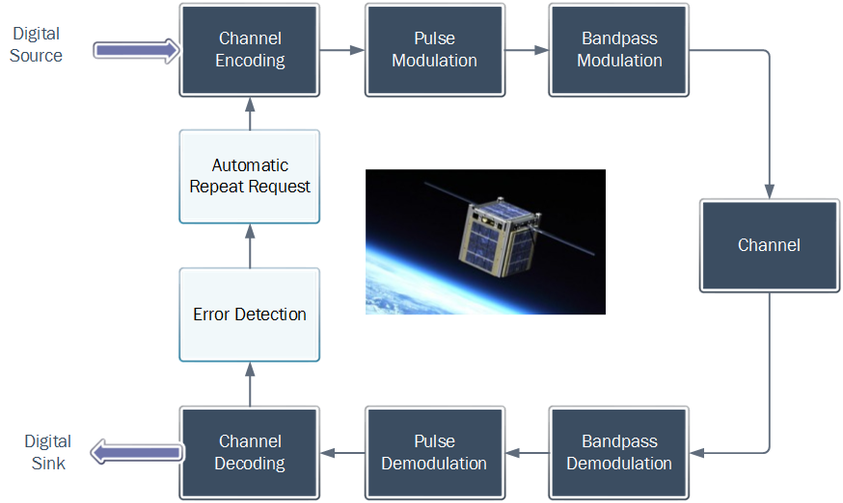
What is amateur radio satellite telemetry?
Amateur radio satellite telemetry allows hobbyist’s and enthusiasts to receive satellite signals.
AFSK and BPSK are amongst the most common modulation schemes.
The common data rates are 1200 b/sec and 9600 b/sec.
Historically these modems were implemented using analog and discrete logic.
More recently, hobbyists and enthusiasts have shifted towards SDR and Raspberry pi.
This senior design aims to demonstrate how a low cost FPGA can also be used to implement a satellite modem.

Slide 3
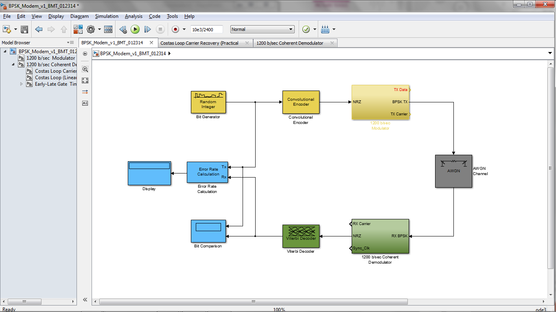
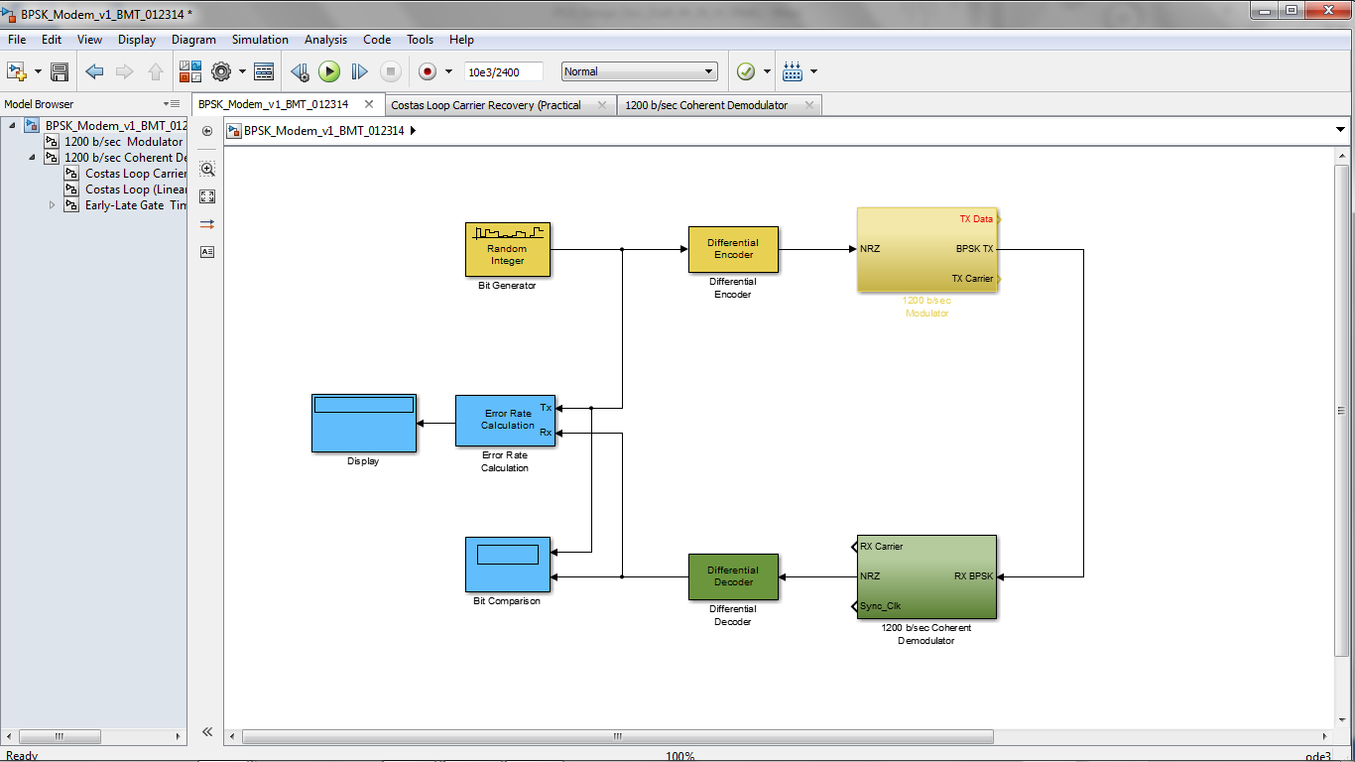
Senior Design I vs. Senior Design II
Proposed FPGA Implementation (SDI)
1200 b/sec FEC-BPSK Modem
(2,1,7) Convolutional Encoding with Viterbi Decoding
AWGN Channel
Squaring Loop Carrier Phase Recovery
Early-Late Gate Timing and Data Recovery
Final FPGA Implementation (SDII)
1200 b/sec DE-BPSK Modem
Differential Encoding and Decoding
Costas loop Carrier Recovery
Early-Late Gate Timing and Data Recovery
NO AWGN
NO FEC
Simulink design of the BPSK modem (SDI)
Simulink design of the BPSK modem (SDII)

Slide 4
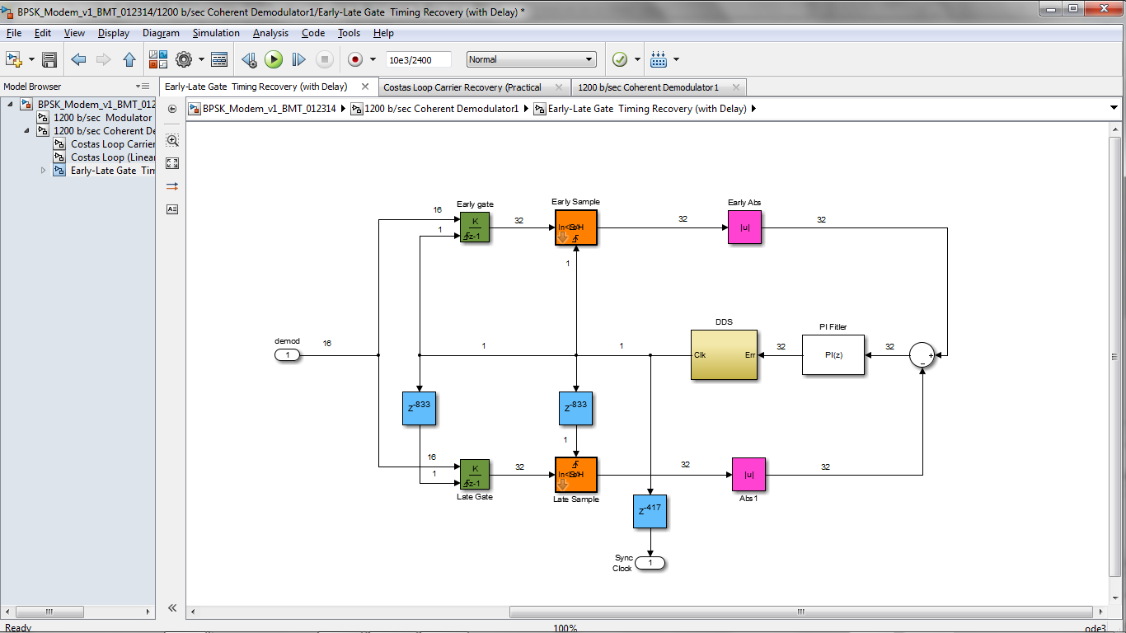
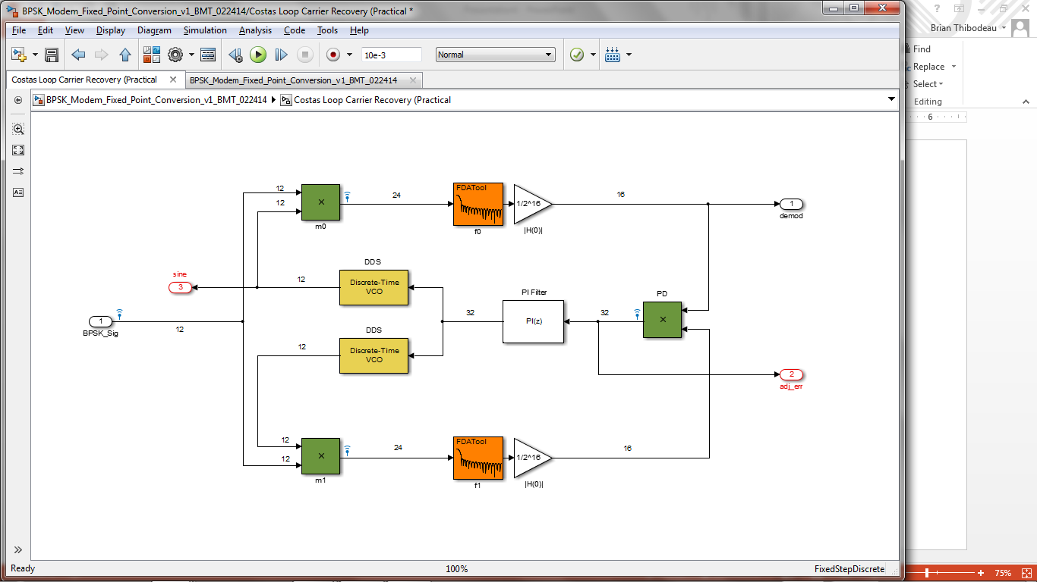
Specifications/Requirements of Primary Circuits
Simulink model of the Early-Late Gate
Costas Loop Carrier Recovery Circuit
2 MHz sampling frequency
12 bit BPSK input from Modulator
4800 Hz local oscillator (2)
9600 Hz cutoff frequency for Arm Filters (2)
PI filter for error adjustment
32 bit phase increment
Tracks phase and frequency steps
Early-Late Gate Timing and Data Recovery
2 MHz sampling frequency
16 bit demodulated input from Costas Loop
1200 Hz local oscillator (data rate)
Late clock delay: 417 samples (1/2 period)
Sync clock delay: 208 samples (1/4 period)
PI filter for error adjustment
32 bit phase increment
Simulink model of the Costas Loop

Slide 5
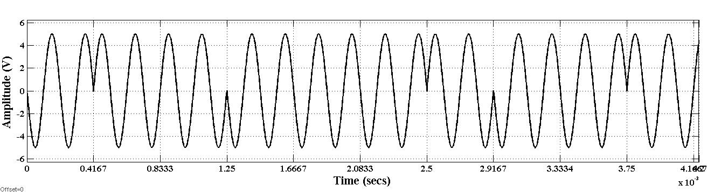
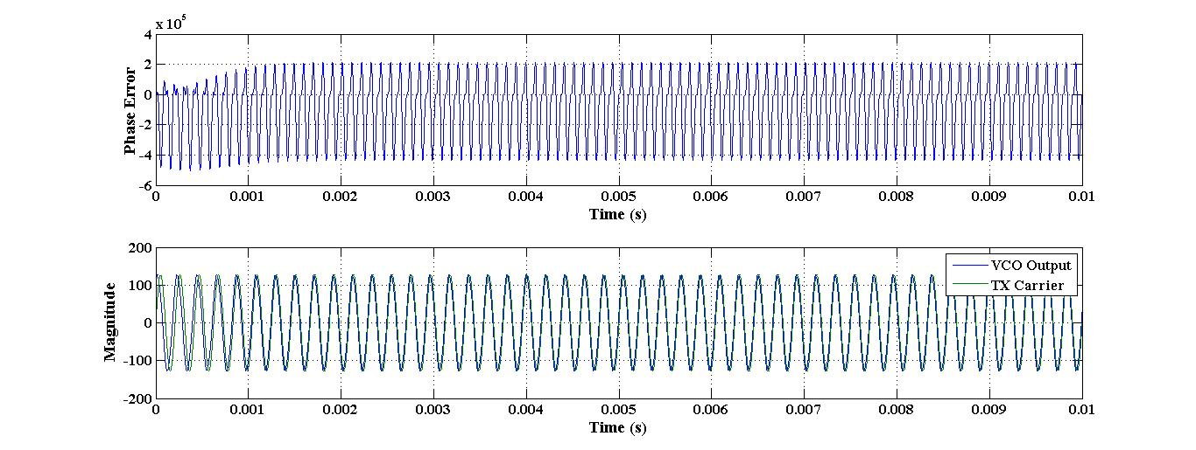
Simulink Results/ Costas Loop
1200 Hz BPSK signal, adjusted phase error and extracted carrier
Costas Loop Carrier Recovery Circuit
Simulated under phase and frequency steps.
Maximum lock is range +/- 200Hz from center frequency (4800 Hz)
PI loop filter
Second order-Type I
Settling Time: < 5ms (Approx. 5 bit times)
Steady state errors
Phase steps: 0
Frequency steps: 1/Ko

Slide 6
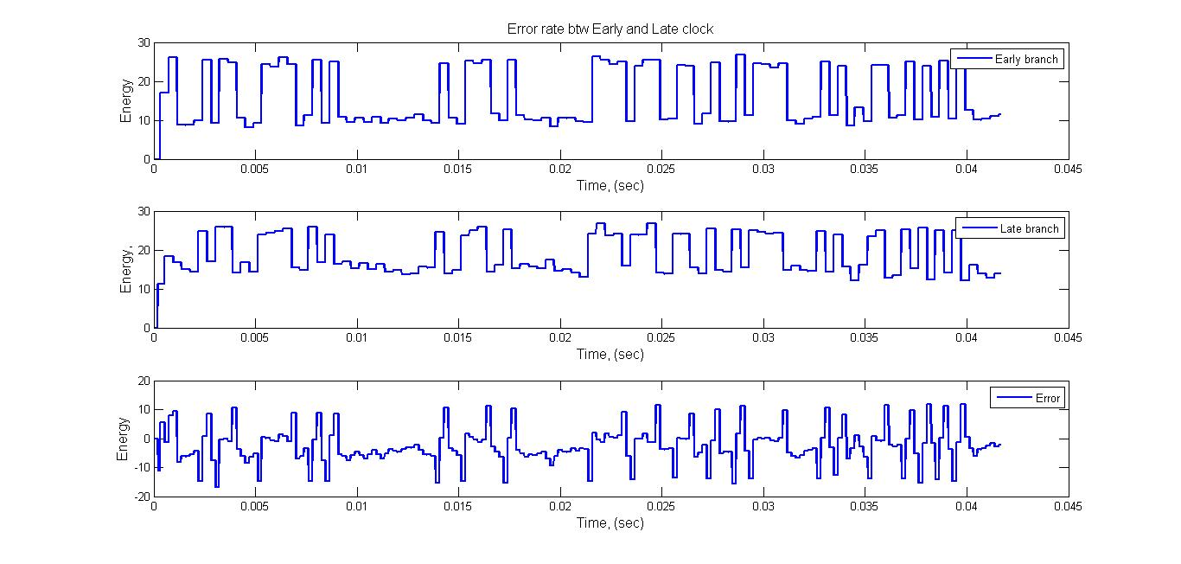
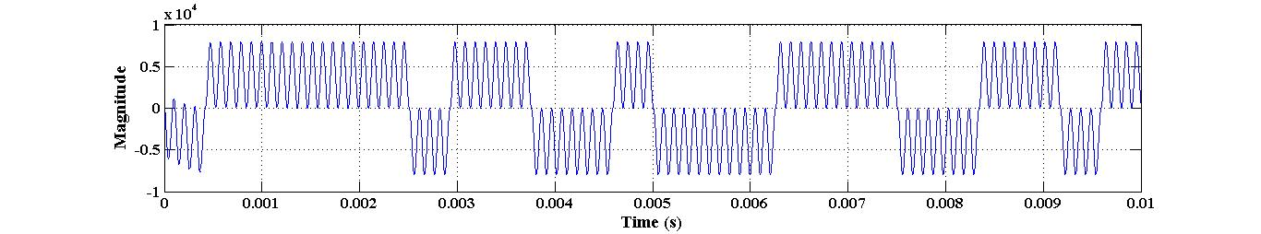
Simulink Results / Early Late Gate
Unprocessed NRZ
Error signal
Early Late Gate Timing Recovery Circuit
2 MHz sampling frequency
16 bit Unprocessed NRZ from Costas Loop
Early branch processed by the extracted clock
Late branch processed by the extracted clock (T/2 delay)
Error is the difference btw the accumulated energy (E_{Early}-E_{Late})
Mean of 0 over the bit period
Accumulated Energy w/ Early & Late timing
Early clock extracted clock
Late clock extracted clock (T/2 delay)
PI filter for error adjustment
Simulink model of the Early-Late Gate

Slide 7
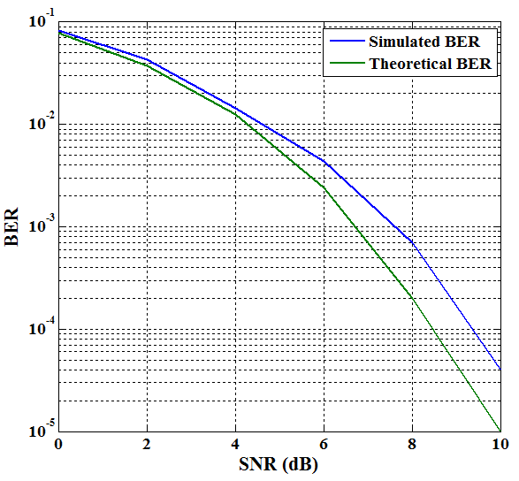
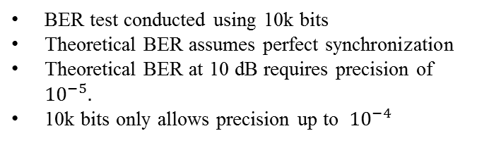
Simulink Results (BER plot)
Simulink design of the BPSK modem (SDII)
BER test conducted using 10k bits
Theoretical BER assumes perfect synchronization
Theoretical BER at 10 dB requires precision of ${10}^{−5}.$
10k bits only allows precision up to ${10}^{−4}$
BER comparison

Slide 8
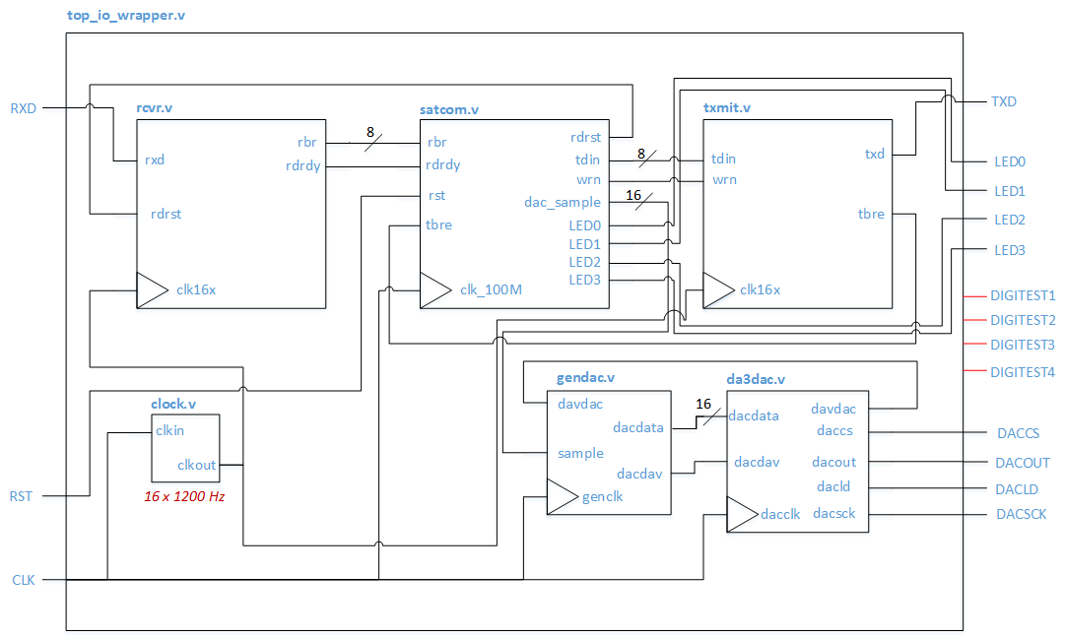
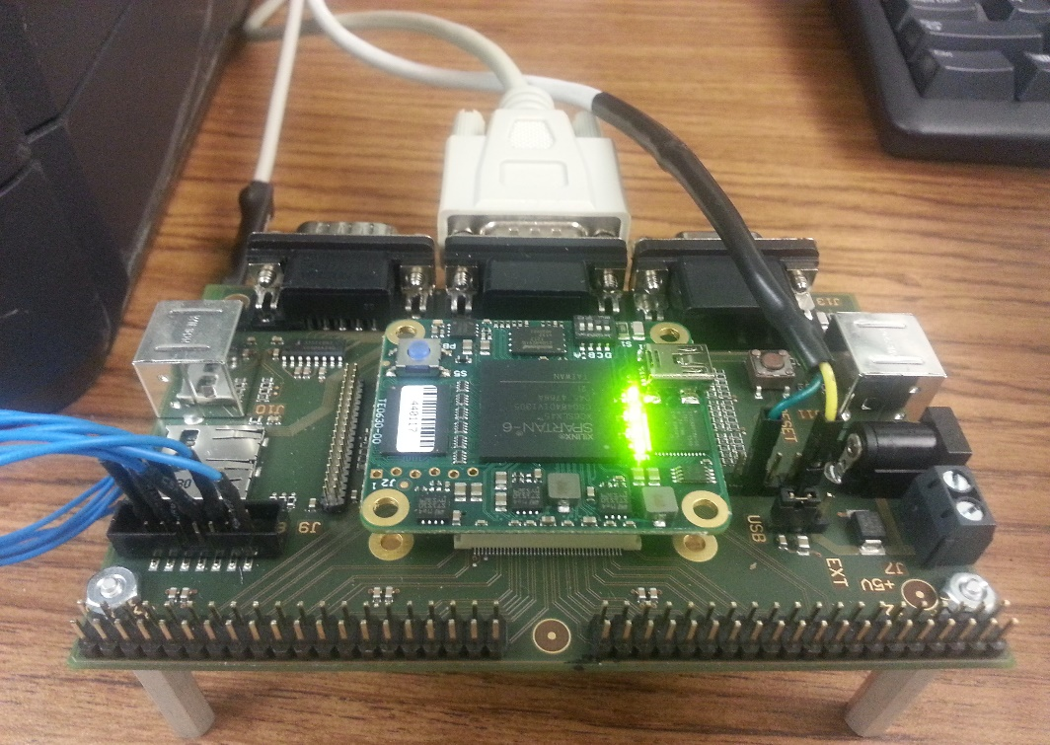
Hardware Implementation
TE0630 Spartan-6 FPGA
LX45
DSP48A1 (58)
User I/O (358)
TE0304 Carrier Board
Connection to FPGA I/O signals
1x6 Pmod (2)
JTAG Header for programming
RS-232 for HW - USB
Top I/O wrapper for the modem
RS-232 communication
rcvr.v (Receiver module )
txmit.v (Transmit module)
Modulator/ demodulator
Satcom.v
gendac (DAC interface)
User LEDs for testing (4)

Slide 9
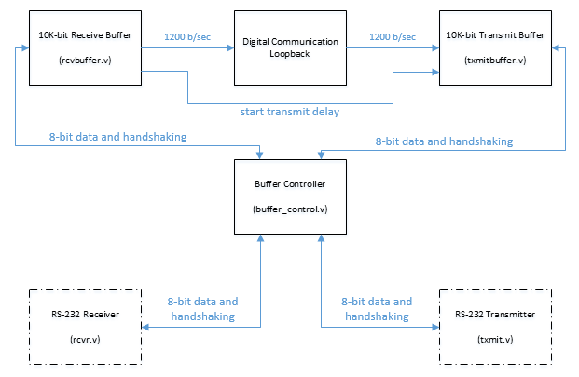
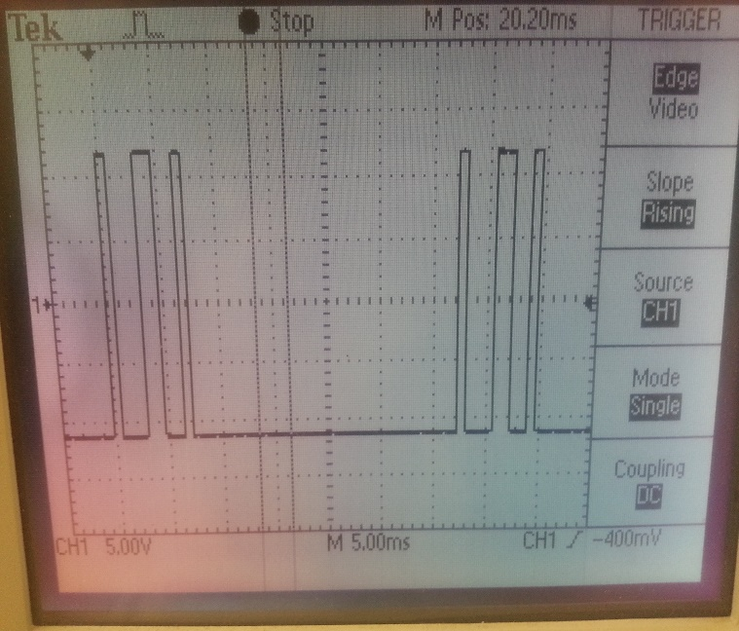
PC/FPGA Interface using RS232
ASCII characters were shown to have a 25 ms delay between characters
Had to be compensated for in the design of the Transmit and Receive buffers
High-level block diagram depicting the RS-232 receiver/transmitter modules

Slide 10
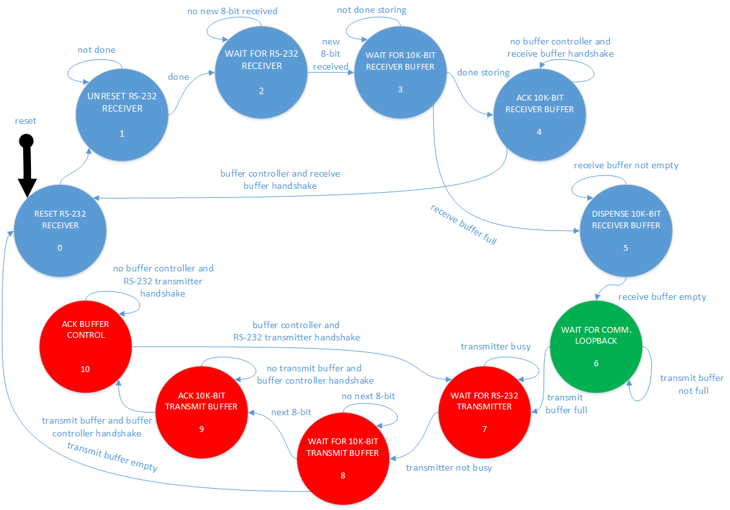
PC/FPGA Interface using RS232
State machine for the RS-232 control between the FPGA and the PC

Slide 11
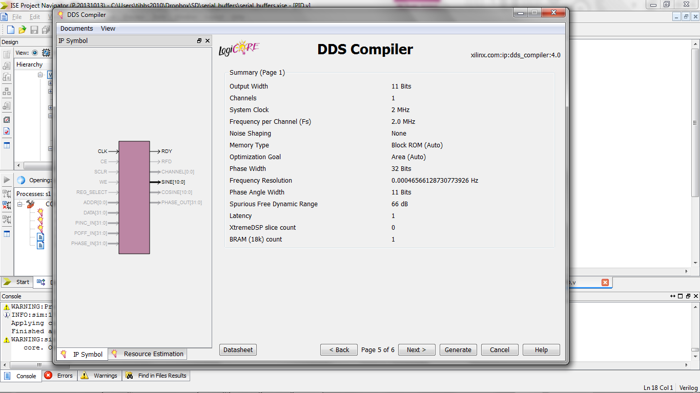
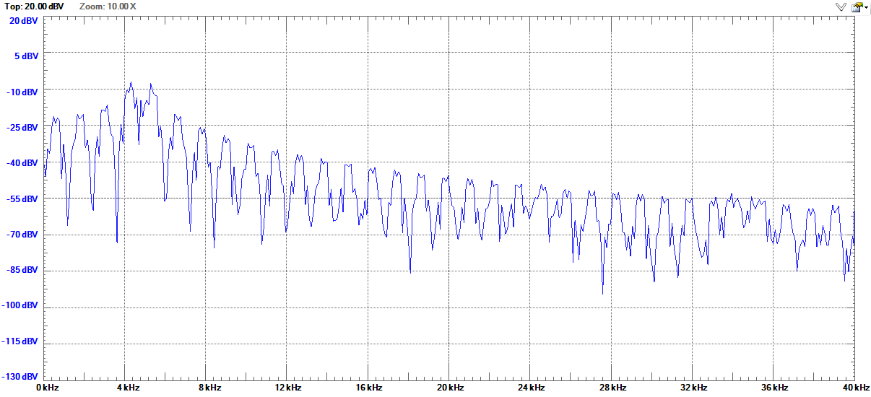
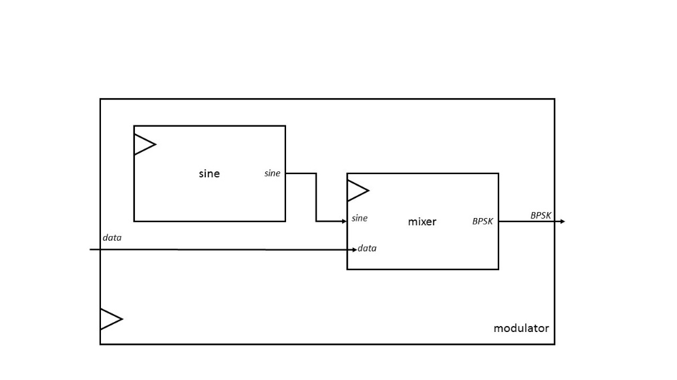
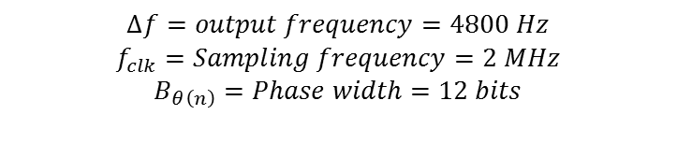
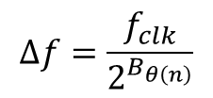
Implementation of BPSK Modulator
FFT of BPSK signal
Suppressed carrier at 4800 Hz
First Null at 6000 Hz (carrier + bit rate)
DDS Compiler configuration for a 1200 Hz sinusoidal
$$∆f=\frac{f_{clk}}{2^{B_{θ\left(n\right)}}}$$
$$∆f=output frequency=4800 Hz$$
$$f_{clk}=Sampling frequency=2 MHz$$
$$B_{θ\left(n\right)}=Phase width=12 bits$$
Block model for the modulator module

Slide 12
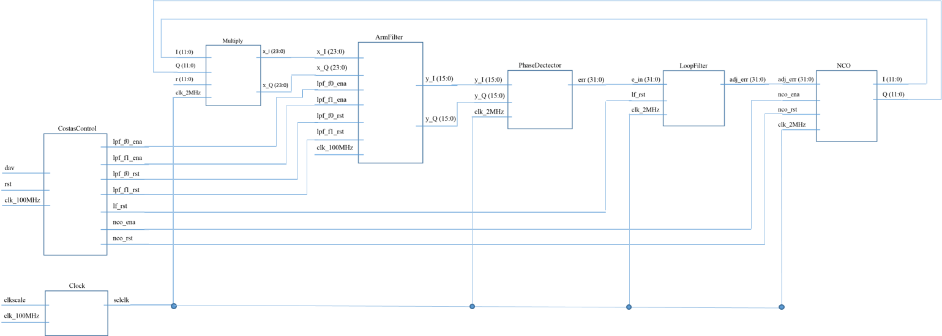
Implementation of BPSK Demodulator: Costas Loop

Slide 13
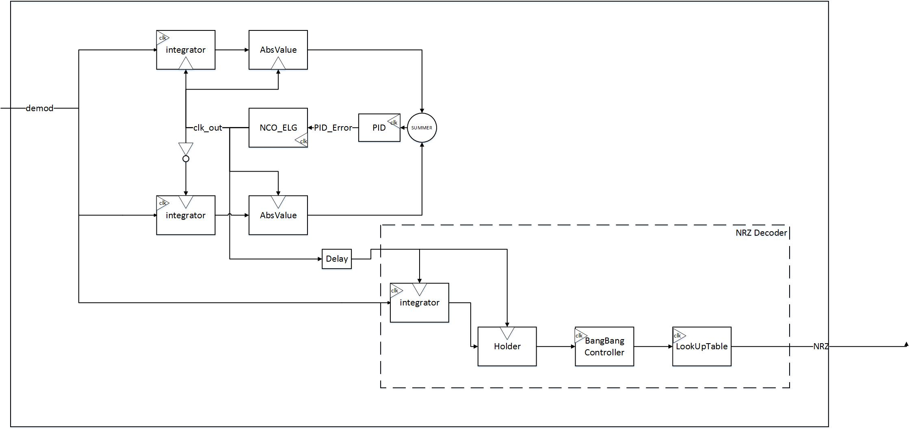
Implementation of BPSK Demodulator: Early-Late Gate

Slide 14
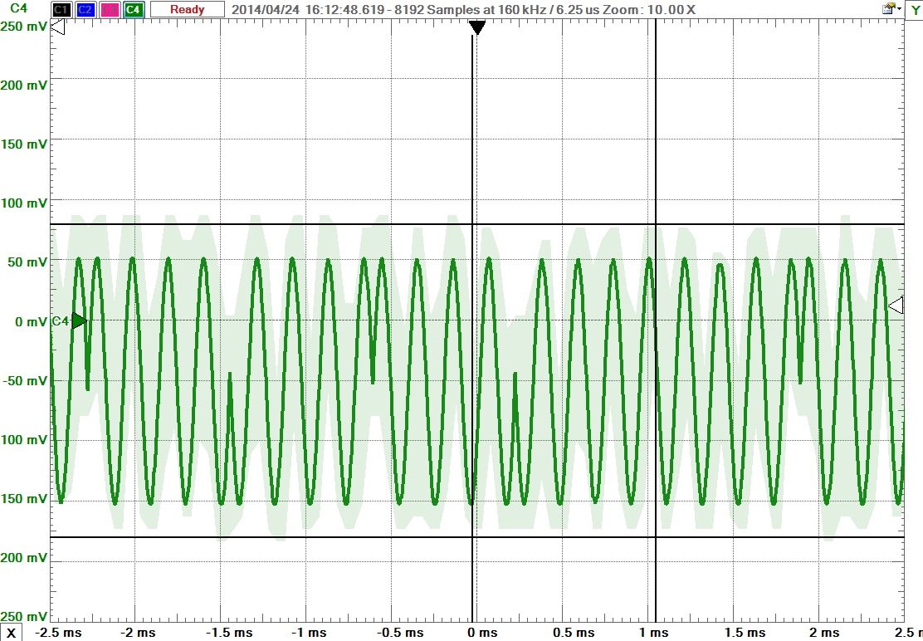
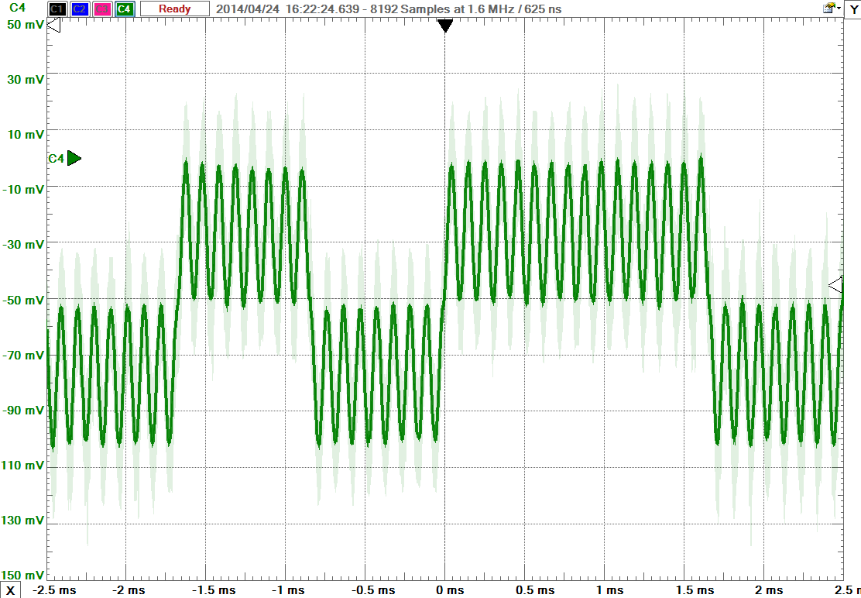
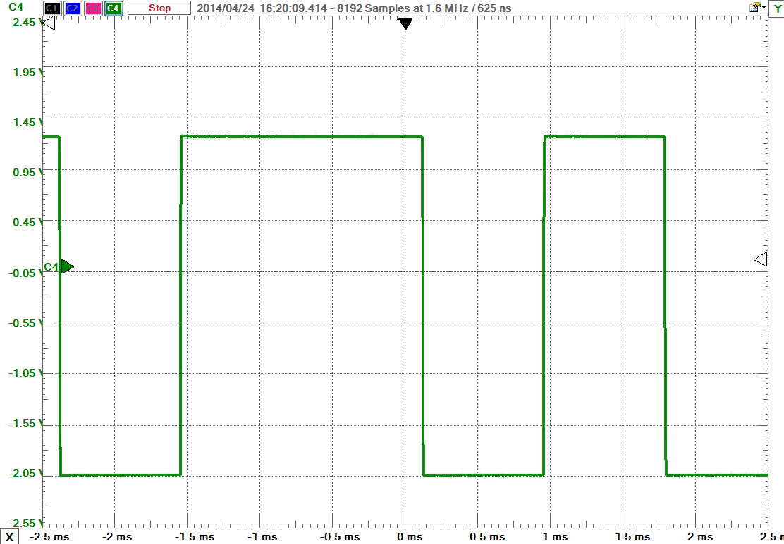
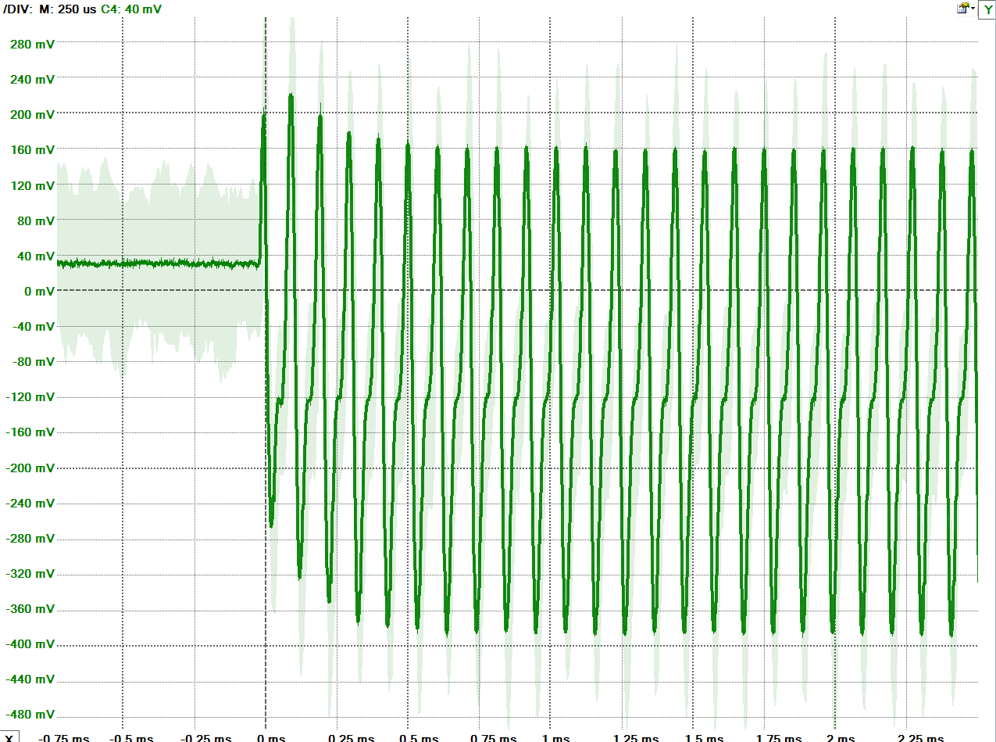
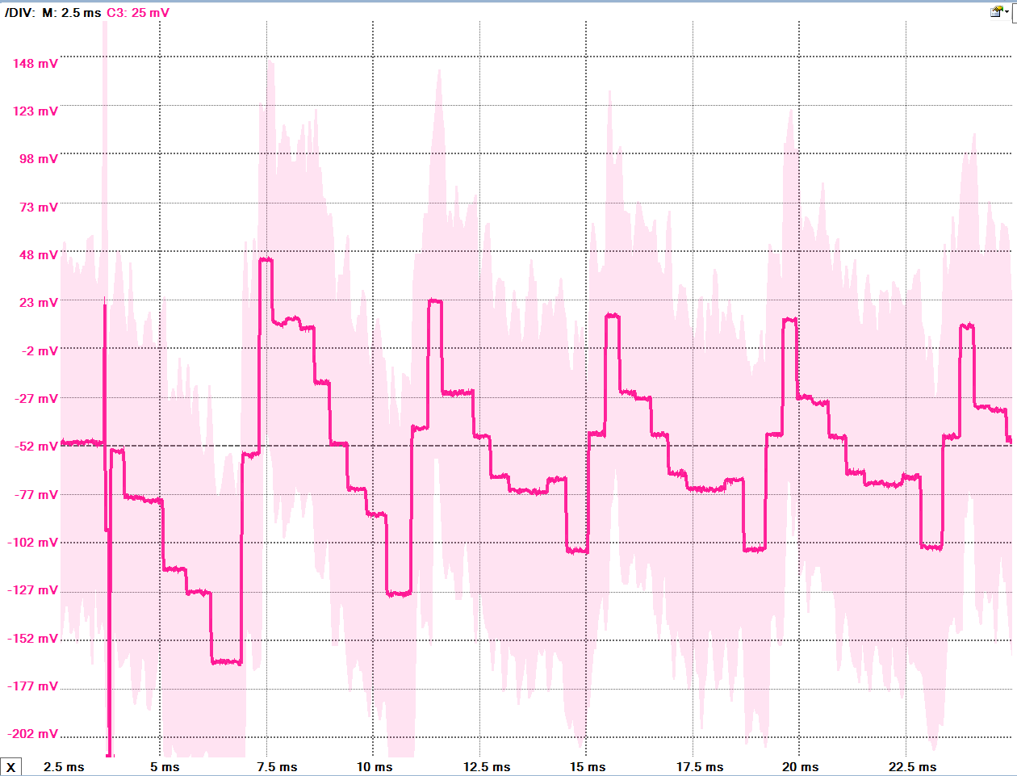
Hardware Evaluation using Electronics Explorer
Modulated BPSK signal
Demodulated BPSK signal
Decoded NRZ bits
Costas Loop error signal
Early-Late Gate error signal

Slide 15
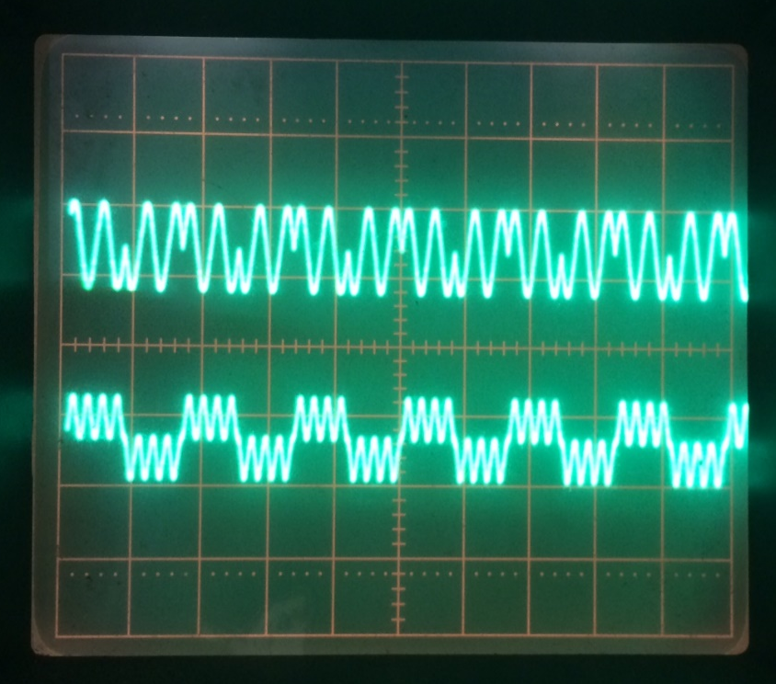
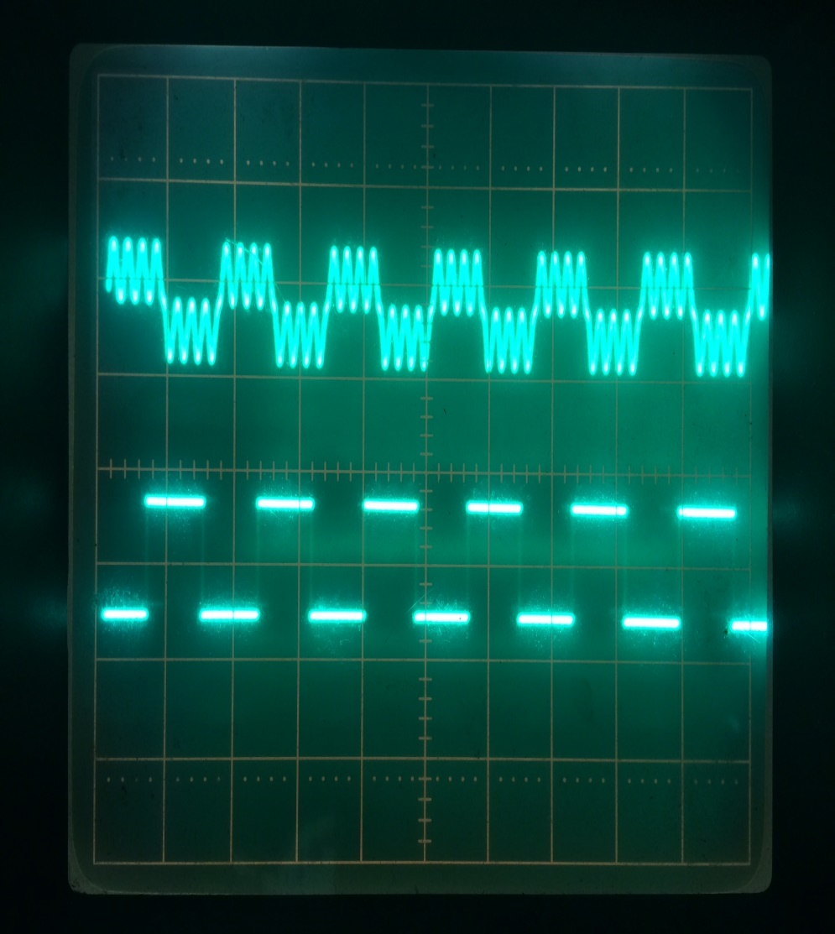
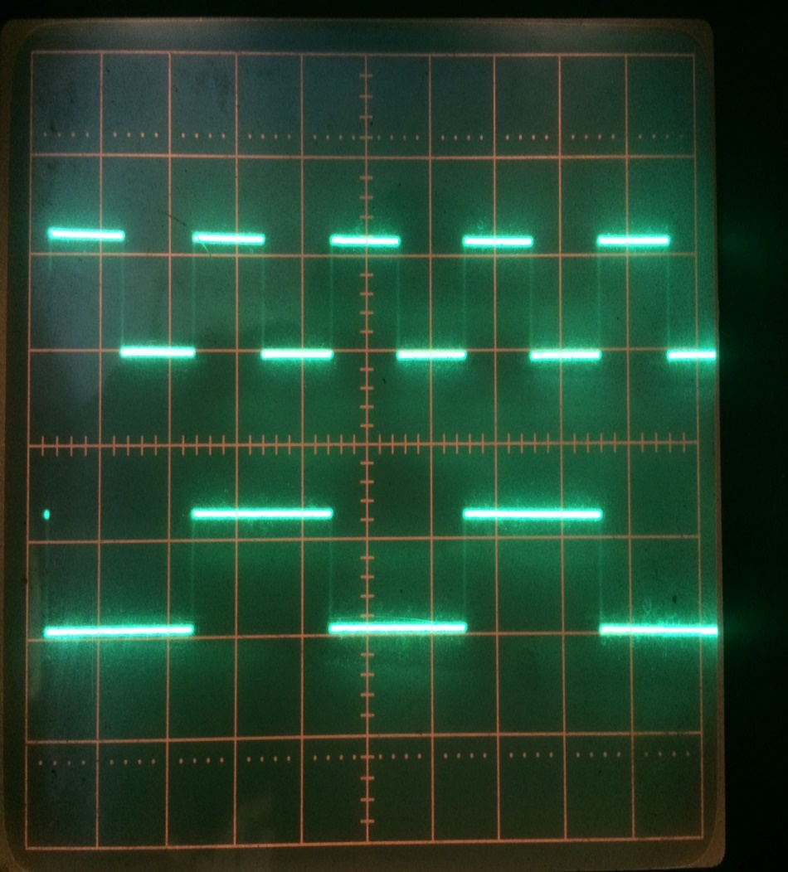
Hardware Evaluation using PmodDA2 and Oscilloscope
a.) Modulated BPSK signal & demodulated signal b.) demodulated & extracted clock c.) extracted clock & decoded NRZ
Evaluated using a repeating bit stream of 1010101… Results in a.) and b.) were displayed at 1ms/div and 2 volts/div
Results in c.) were displayed at 0.5 ms/div and 2 volts/div

Slide 16
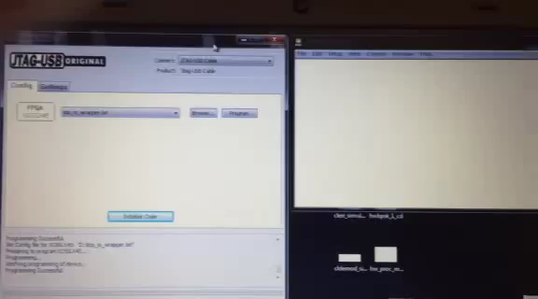

Slide 17
Implementation Challenges: Viterbi Decoder
Simulated (ISIM) results from the implementation of the Viterbi Decoder
Simulated (ISIM) results from the implementation of the Viterbi Decoder

Slide 18
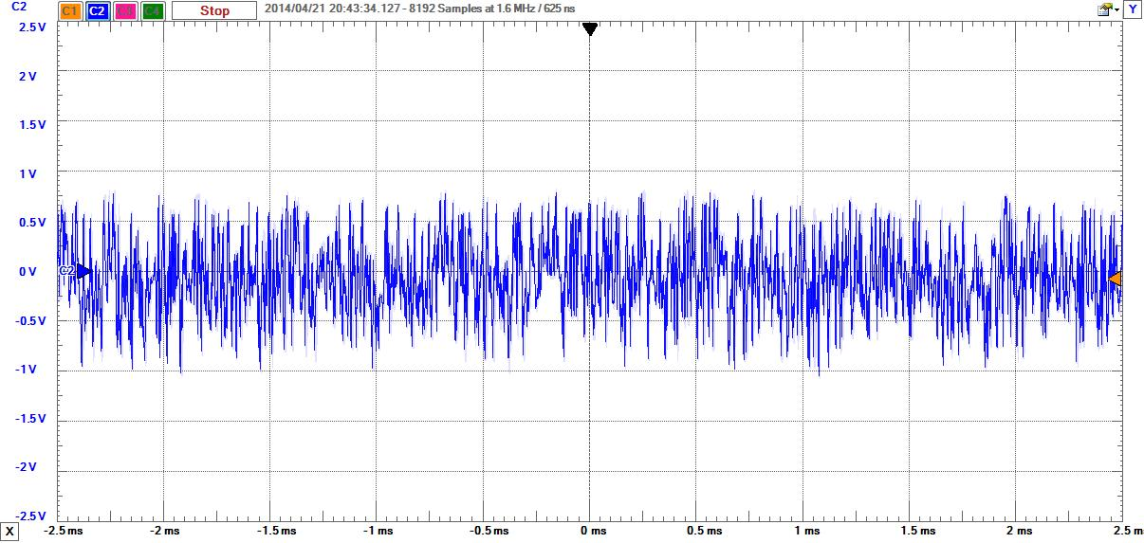
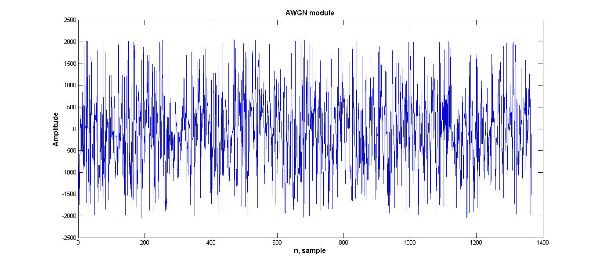
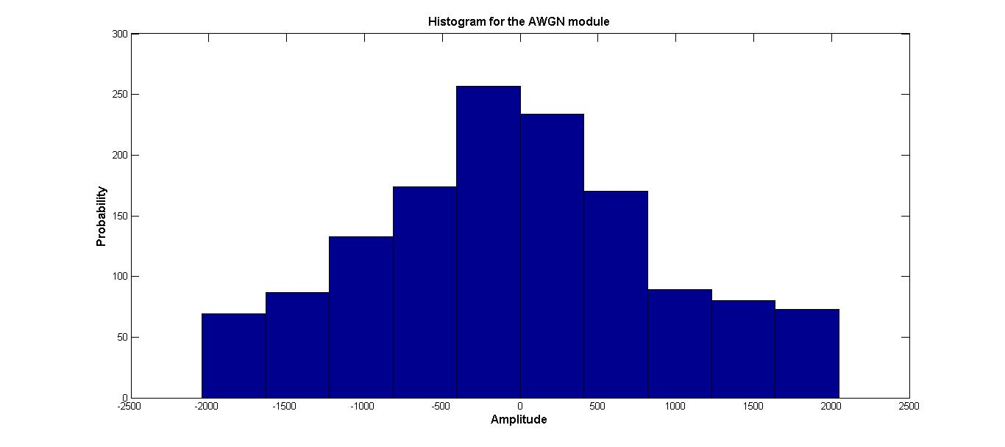
Implementation Challenges: AWGN Core
The AWGN output did not match our Simulink predictions
This may result from the DAC interface w/ its -1.65 – 1.65 V output

Slide 19
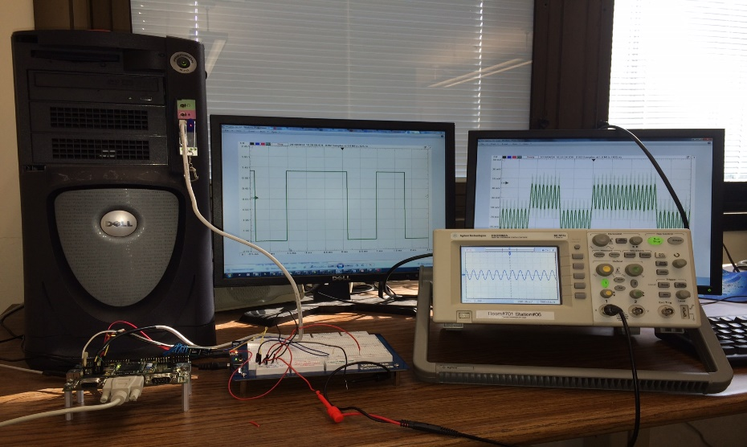
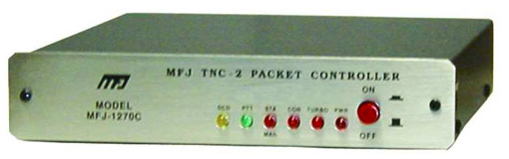
Conclusion and Future Work
This senior design project designed and implemented a 1200 b/sec BPSK modem in FPGA for amateur radio satellite telemetry
In SDI, the specifications and requirements were identified. The modem was designed and simulated in Matlab/Simulink
In SDII, the Matlab/Simulink model was implemented in FPGA using a Spartan 6
The 1200 b/sec modem was evaluated in terms of synchronization capabilities and error rate under NO noise.
In simulation, the BER closely approximated theory
Future work includes:
The addition of linear block codes for modem resiliency.
Implement Type II Costas Loop for Doppler shift correction
Interface a TNC and analog front end to communicate in real-time environments
Evaluate BER in real-time environments.
Publish in amateur radio community journal, QST

